Slide 1
Basic Refrigeration
Carrier Transicold
One Week Container Service Training Course

Slide 2
Rules to Learning Refrigeration
Rule 1. Learn the Basics
Rule 2. Learn the Basics
Rule 3. Learn the Basics

Slide 3
What is Refrigeration
Cooling by the removal of heat.
The MOVEMENT of HEAT from a place where it is not wanted to a place where it is Unobjectionable.

Slide 4

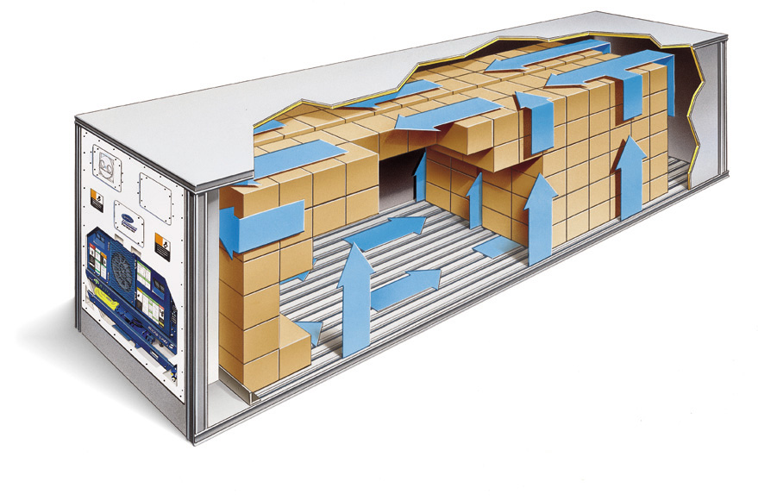
Refrigeration
HEAT NOT WANTED UNOBJECTIONABLE
Insert Container Photo here.

Slide 5
Heat
What is heat ?
A form of energy
What is cold ?
Absence of heat
How does heat flow ?
High Heat to Low Heat
Does cold flow ?
No
How do we measure it ?
British Thermal Unit (BTU)

Slide 6
British Thermal Unit (BTU)
Heat is a form of energy, and is measured in BTU’s.
A BTU is the quantity of heat required to raise ONE POUND of WATER ONE DEGREE FAHRENHEIT at Sea Level.
Example: To raise the temperature of 2 lbs. of water from 80 to 85 Degrees F. would require BTU’s of heat.
10 BTU’s

Slide 7
Heat
Heat flows from high energy level to a lower energy level.
Heat will not flow without a temperature difference.
The greater the temperature difference, the faster the energy will flow.

Slide 8
Heat Flows in Three Ways:
CONDUCTION
CONVECTION
RADIATION

Slide 9
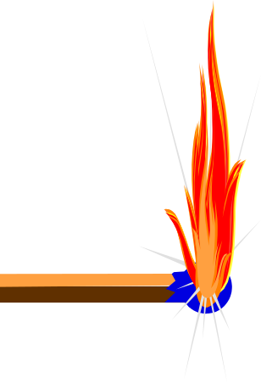

Conduction
The Transfer of Heat from Molecule to Molecule through a substance by Chain Collision.
  Example: Heating one end of a copper tube, will cause the other end to get hot.

Slide 10

Convection
Heat Transfer By The Movement Of Molecules From One Place To Another.
  Examples: Convection oven & Forced Air Furnace

Slide 11
Radiation
Transfer of Heat by Passing from a Source to an Absorbent Surface without heating the space in between.
  Example: Sunlight goes through a window without heating the glass but heats the surface in the room it is shining on.

Slide 12
Temperature
Temperature indicates the average velocity of molecules of a substance .
As the heat energy in a substance increases, it’s molecules vibrate more intensely.
  What does a thermometer measure?
  The Intensity of their Vibration.

Slide 13
Temperature
FAHRENHEIT CELSIUS
BOILING PT > 212 100
FREEZING PT > 32 0
ABSOLUTE 0 > -459.7 -273

Slide 14
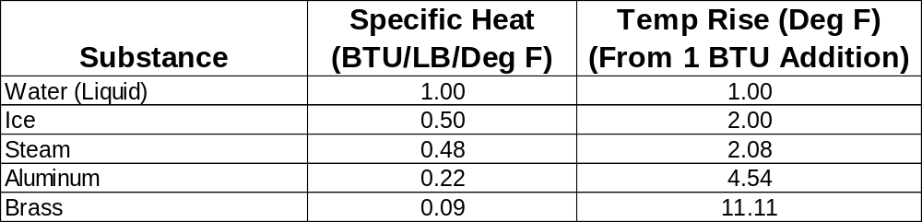
Specific Heat
The Amount of Heat (Measured In BTU’s) required to raise ONE POUND of a Substance ONE DEGREE FARENHEIT.
  EXAMPLES:

Slide 15
Heat Energy
There are two types of Heat Energy:
    Sensible Heat
    Latent Heat

Slide 16

Sensible Heat
Is the energy of molecular motion.
Causes a change in Temperature with No change in State.
The addition or removal of sensible heat CAN be measured with a thermometer as it causes an increase in molecular motion.

Slide 17

Latent Heat
Is the energy of molecular separation and arrangement.
Causes a Change in State, with No change in Temperature.
Latent Heat CANNOT be measured with a Thermometer.

Slide 18
Enthalpy - 1 lb. Water
Temp (Deg. F.)
250
212 (100°C)
Sensible Heat
200
Latent Heat of Vaporization
150
100
Sensible Heat
50
Heat Energy is added to 32°F (0 °C) Water (liquid)
32 (0°C)
25
100 200 400 600 800 1000 1100 1200
BTU’s
180 BTU’s are required to reach Boiling Point
970 BTU’s are required to change the state from a liquid to a vapor

Slide 19
Definitions
Saturation Temperature
Saturated Mixture
Sub-Cooled Liquid
Super Heated Vapor

Slide 20
Saturation Temperature
The Temperature at which a substance will change state from a liquid to a vapor or a vapor to a liquid with either the addition or removal of heat.
  Add Heat = Liquid to Vapor
    Vaporization
  Remove Heat = Vapor to Liquid
    Condensation

Slide 21
Saturated Mixture
At a Temperature Equal to it’s Boiling Point or Condensing Point, the state of the refrigerant is Both Vapor and Liquid.
Addition of Heat = Boiling
Removal of Heat = Condensing

Slide 22
Sub-Cooled Liquid
At a Temperature BELOW it’s Boiling Point, the refrigerant state is 100% LIQUID, there is NO vapor present.
What is the state of the following: 1 lb. of water at sea level @ 200 degrees F.?
  Sub-Cooled Liquid.
  Sub-Cooled by 12 degrees F.

Slide 23
Superheated Vapor
At a Temperature ABOVE it’s Boiling Point, the refrigerant state is 100% Vapor, there is NO liquid present.
What is the state of the following: 1 lb. of water at sea level @ 220 degrees F.?
  Superheated Vapor.
  Superheated by 8 degrees F.

Slide 24
Enthalpy - 1 lb. Water
Temp (Deg. F.)
Temperature at 212°F (100°C) = Saturated Mixture
250
Temperature Above 212°F (100°C) = Superheated Vapor
212 (100°C)
200
150
Saturation Temperature of Water is 212°F (100°C) at Sea Level
(0 PSIG / 14.7 PSIA)
100
Temperature below 212°F (100°C) = Sub-cooled Liquid
50
32 (0°C)
25
100 200 400 600 800 1000 1100 1200
BTU’s

Slide 25
Enthalpy - 1 lb. Water
Temp (Deg. F.)
Latent Heat of Vaporization
Saturated Mixture until water changes state from liquid to 100% vapor
250
212 (100°C)
Superheated Vapor after the change of state
200
Sensible Heat
150
Sub-cooled Liquid until reaching Saturation Temperature
100
Sensible Heat
Heat Energy is added to 32°F (0°C) Water (liquid)
50
32 (0°C)
25
100 200 400 600 800 1000 1100 1200
BTU’s
180 BTU’s are required to reach Boiling Point
970 BTU’s are required to change the state from a liquid to a vapor

Slide 26
Enthalpy - 1 lb. Water
Temp (Deg. F.)
Latent Heat of Condensation
Saturated Mixture until water changes state from vapor to 100% liquid
250
212 (100°C)
Superheated Vapor until reaching Saturation Temperature
200
150
Sub-cooled Liquid below Condensing Point
Sensible Heat
100
50
Sensible Heat
Heat Energy is removed from Superheated Vapor
32 (0°C)
25
100 200 400 600 800 1000 1100 1200
BTU’s
970 BTU’s are required to change the state from a vapor to a liquid

Slide 27
Pressure / Weight
Is defined as FORCE PER UNIT of AREA
And can be measured in:
  PSI (Pounds per Square Inch)
  Bars (when using the celsius scale)
  Kilograms per Square Centimeters
We can now measure System Pressures!

Slide 28

Atmospheric Pressure
At Sea Level, the Atmospheric Pressure on our bodies is 14.7 PSIA Pounds per Square Inch Absolute.
  A column of air, one inch square and 60 miles high weighs 14.7 pounds.
1 Square Inch
Column of air
60 Miles
14.7 Pounds Pressure
Standing at Sea Level

Slide 29
Pressure Scales
Gauge Scale Absolute Scale
ATMOSPHERE 0 PSIG 14.7 PSIA
(Pressure @ Sea Level) 0 IN HG 29.92 IN HG
VACUUM 29.92 IN HG 0 IN HG
1 Inch of Mercury (on either scale) is equal to 25,400 Microns!
28.92 IN HG
1 IN HG

Slide 30
Pressure Movement
How Does Pressure Flow?
High to Low
What happens when you take two refrigerant bottles, one with refrigerant in it and the other in a vacuum and connect a hose between them and open the valves?
Refrigerant flows to the evacuated bottle until pressures equalize.

Slide 31
Pressure / Saturation Temperature
As Pressure increases, Saturation Temperature increases.
As Pressure decreases, Saturation Temperature decreases.
Pressure / Saturation Temperature FOLLOW each other.
At the Saturation Temperature we have a Saturated Mixture (Both Liquid and Vapor are present).
A technician may need to know the state of the refrigerant as it travels through the system!

Slide 32
Types of Refrigeration Systems
There are two different types of Refrigeration Systems:
Open Loop - refrigerant is only used once, e.g., ice cubes, dry ice, water.
Closed Loop - refrigerant is used over and over again, e.g., a/c, refrigerators, freezers.
Carrier Transicold supplies all closed loop system’s!

Slide 33
Refrigerant
What is a refrigerant ?
A medium to move heat.
A Substance that gives up Heat by Condensing at High Temperatures and Pressures and absorbs Heat by Evaporating at Low Temperatures and Pressures.
Carrier Transicold uses R-22, R-134a, R-404A

Slide 34
Refrigerant
Temp (Deg. F)
Superheated Vapor
Saturated Mixture
42° F
Sub-cooled Liquid
Example: We have R-134a in a closed system and we have a low side pressure of 37 PSIG - What is the saturation Temperature?
BTU’s
Answer = 42 Deg. F. (5.6 Deg. C.)
PT Chpart Introduction

Slide 35
Abbreviation Legend
HT = High Temperature
HP = High Pressure
LT = Low Temperature
LP = Low Pressure
SCL = Sub-Cooled Liquid
SM = Saturated Mixture
SHV = Super Heated Vapor

Slide 36
Color Key to Refrigerant Flow
HT HP SHV
HT HP SM
HT HP SCL
LT LP SM
LT LP SHV
FLASH GAS

Slide 37
4 Component Refrigeration System
All Refrigeration and A/C Systems contain the following components:
  Compressor
  Condenser
  Metering Device
  Evaporator
4 Component Flow Diagram

Slide 38
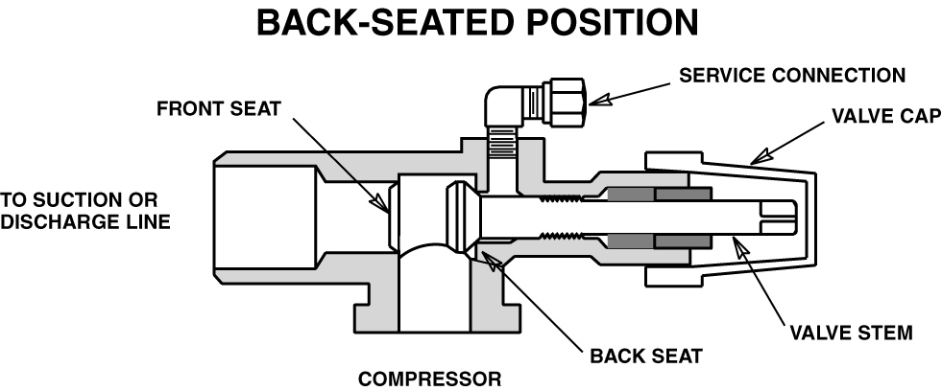
Compressor Service Valves
Open to the system - with NO access to the gauge port!

Slide 39
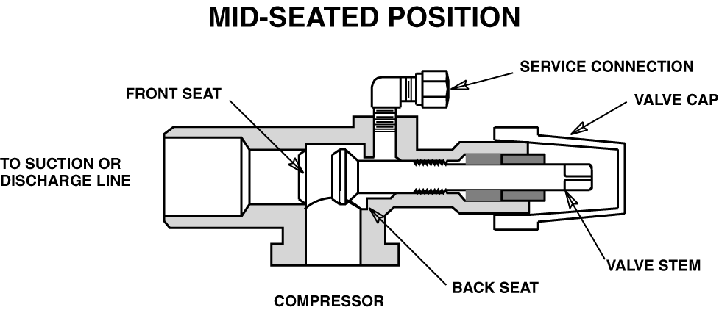
Compressor Service Valves
Open to the system - with access to the gauge port!

Slide 40
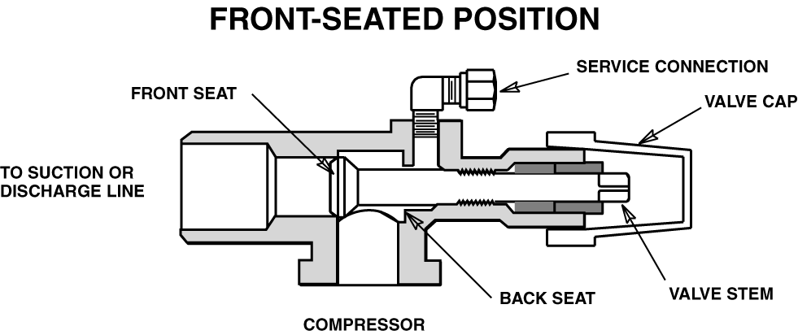
Compressor Service Valves
Flow from the compressor
to the Suction or Discharge
line is stopped
Closed to the system - with Compressor Pressure access to the gauge port!

Slide 41
King Valves
Back-seated Position
Access Port
Connection to Receiver Tank or Liquid Line
Valve Stem
Connection to Receiver Tank or Liquid Line

Slide 42
King Valves
Mid-seated Position
Access Port
Connection to Receiver Tank or Liquid Line
Valve Stem
Connection to Receiver Tank or Liquid Line

Slide 43
King Valves
Front-seated Position
Access Port
Connection to Receiver Tank or Liquid Line
Valve Stem
Connection to Receiver Tank or Liquid Line

Slide 44
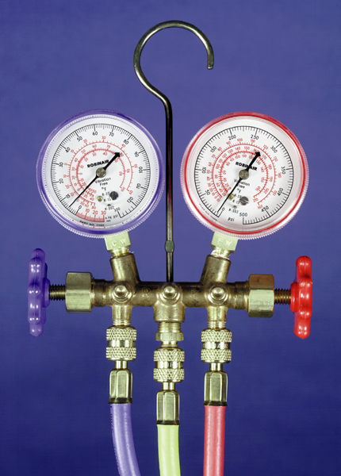
Manifold Gauge Sets
Low Side Gauge - Compound Gauge
High Side Gauge
Utility Hose
Low Side Hose
High Side Hose

Slide 45
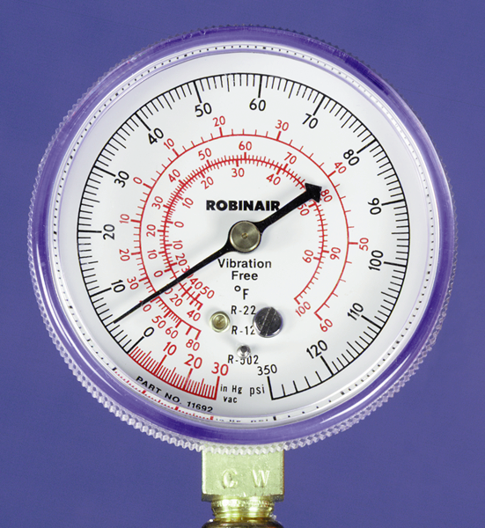
Compound Gauge
Positive Pressure Scale
Built-in PT Charts
Adjustment Screw
Vacuum Scale (Reference Only!)

Slide 46
MGS - Frontseated
High Side Hand Valve
Low Side Hand Valve
Each Gauge is isolated to it’s Hose!

Slide 47
MGS - Low Side Backseated
Low Side Hand Valve
High Side Hand Valve
Low Side Gauge and Utility Hose open to Low Side!

Slide 48
MGS - High Side Backseated
High Side Hand Valve
Low Side Hand Valve
High Side Gauge and Utility Hose open to High Side!

Slide 49
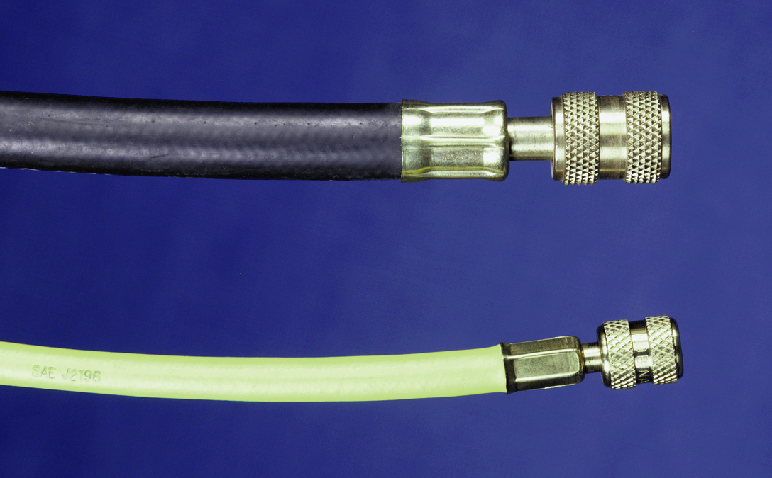
MGS - Hoses
Vacuum Hose - 3/8” Inside Diameter
Standard Hose - 1/4” Inside Diameter

